Slide 1
5.10 Multiplying binomials: special products
Algebra Concepts

Slide 2
Difference of Two Squares
(A + B)(A – B) = A² – B²
Square of the first minus square of the second

Slide 3
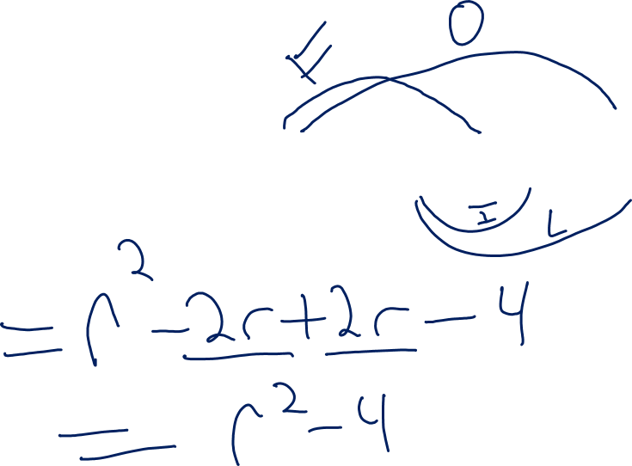
Ex.1)
(r + 2)(r – 2)

Slide 4
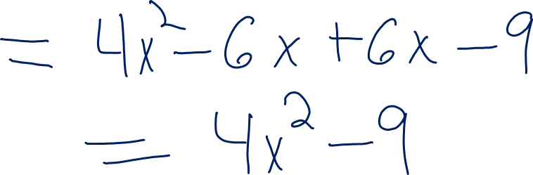
Ex.2)
(2x + 3)(2x – 3)

Slide 5
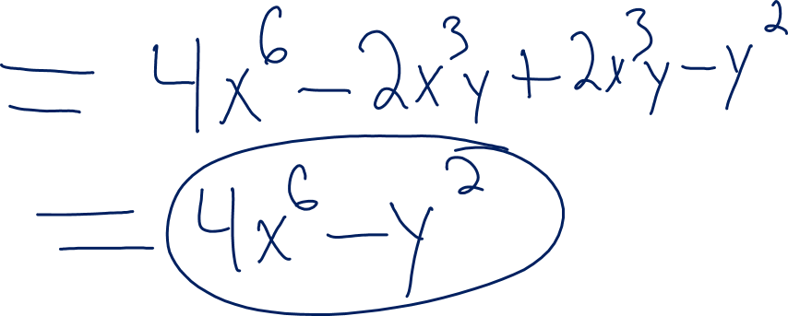
Ex.3)
(2x³ + y)(2x³ – y)

Slide 6

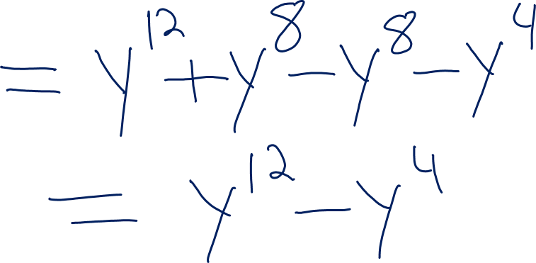
Ex.4)
$(y^{6}−y^{2})(y^{6}+y^{2})$

Slide 7

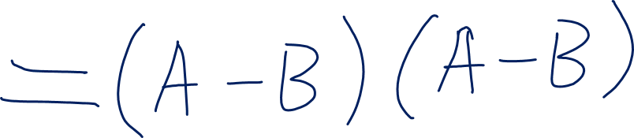
Squaring a Binomial
$${(A−B)}^{2}$$

Slide 8

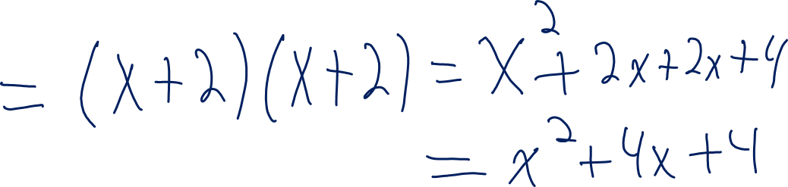
EX. 5)
$${(x+2)}^{2}$$

Slide 9

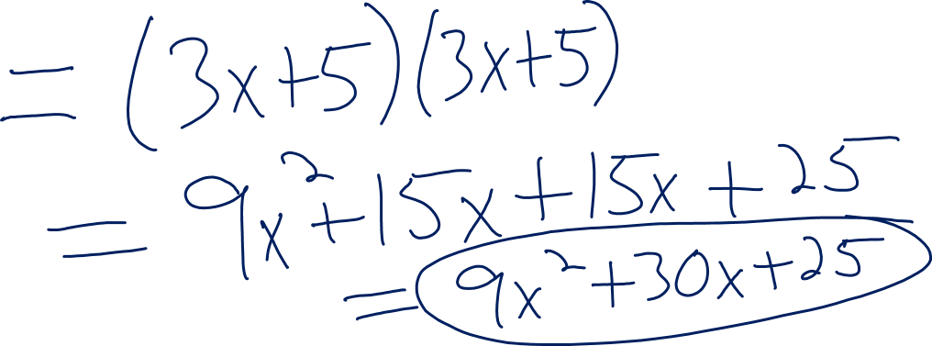
EX. 6)
$${(3x+5)}^{2}$$

Slide 10

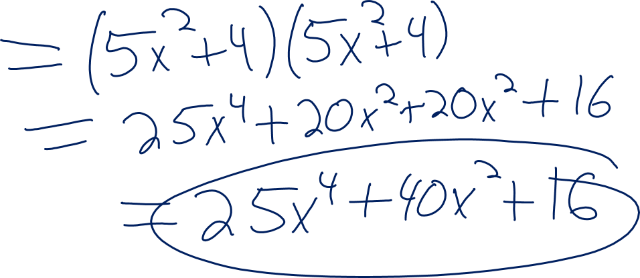
EX. 7)
$${({5x}^{2}+4)}^{2}$$

Slide 11

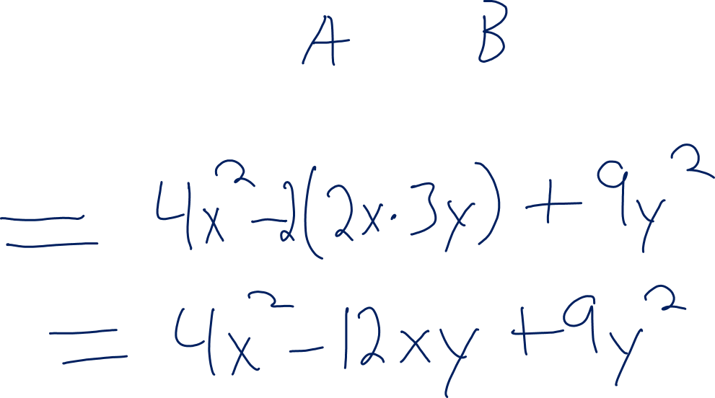
EX. 8)
$${(2x−3y)}^{2}$$

Slide 12

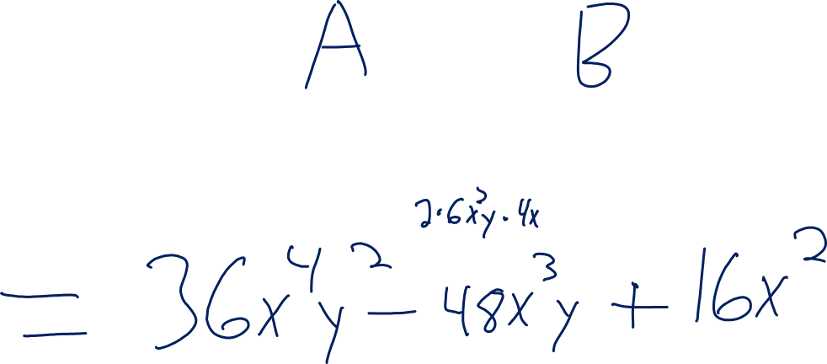
Ex.9)
$${(6x^{2}y−4x)}^{2}$$

Slide 13

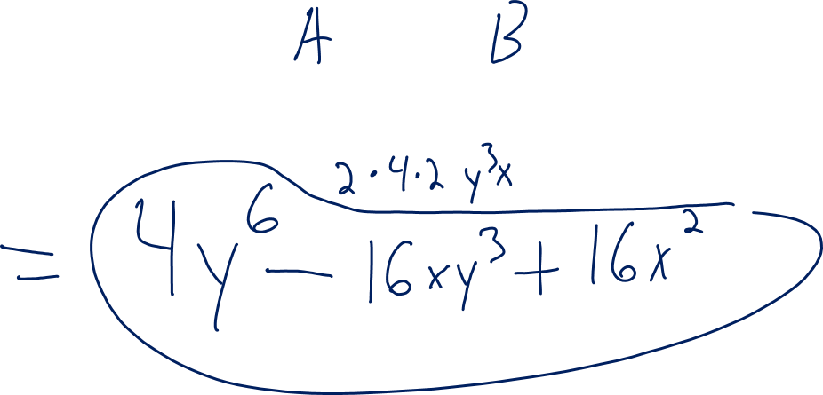
Ex.10)
$${(2y^{3}−4x)}^{2}$$

